Slide 1



Fundamentals of Human-Centered Robotics - 2024 SS: Final Presentation
Robothon - Team H
Team members:
Theresa Gräbner, Peishi Liu
20.August 2024
Notes:
‹#›

Slide 2
Overview
Notes:
‹#›

Slide 3
Software
Simulation:
CoppeliaSim 4.1.0 , rviz
Robot Model:
Provided, Pyrep’s Panda, Panda URDF
Prog. Languages:
Python, CPP
Important Libraries:
Pyrep, Pinocchio, MoveIt
Theresa Gräbner, Peishi Liu | Final Presentation | 20 August 2024
‹#›
Notes:
‹#›

Slide 4
Task Distribution
Theresa Gräbner
Task 1
Task 3
Peishi Liu
Task 2
Theresa Gräbner, Peishi Liu | Final Presentation | 20 August 2024
‹#›
Notes:
‹#›

Slide 5
Task 1
Notes:
‹#›

Slide 6
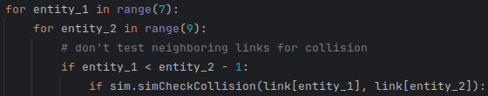
Task 1.1
Goal: Test joint configurations for their validity
Model: Given Franka Panda robot
Implementation:
Self-Collision check:
Write result in json format in “task1_1_self_collision.data”
Theresa Gräbner, Peishi Liu | Final Presentation | 20 August 2024
‹#›
Notes:
‹#›

Slide 7
Task 1.2
Goal:
Model: Pyrep’s Panda Robot
Implementation:
Scene without floor → not interested in collision with floor
Plan cartesian trajectory
Plan joint trajectory
Joint Configuration
Cartesian Pose
Check validity
Plan normalized Path
Replan alternative path
Check validity
Plan linear Path
Replan alternative, nonlinear path
Theresa Gräbner, Peishi Liu | Final Presentation | 20 August 2024
‹#›
Notes:
‹#›

Slide 8
Task 1.2: Cartesian Trajectories
Implementation:
Load Cartesian Pose
Extract quaternions and position coordinates via Pinocchio
Test Cartesian Pose
Reachability: Sample valid joint configuration
Linear Trajectory: Pyrep’s get_linear_path
Nonlinear Trajectory: Pyrep’s get_nonlinear_path
Write result in json format in “task1_2_cartesian_trajectory.data”
Theresa Gräbner, Peishi Liu | Final Presentation | 20 August 2024
‹#›
Notes:
‹#›

Slide 9

Task 1.2: Joint Trajectories
Implementation:
Load joint configuration
Reachability: Test if joint configurations are within the limits defined by Franka’s official website
Validity: Configuration does not cause self-collision
Normalized Trajectory:
Calculate trajectory
Validate each path point
Alternative Path: Modified PyRep’s get_path
Write result in json format in “task1_2_joint_trajectory.data”
Theresa Gräbner, Peishi Liu | Final Presentation | 20 August 2024
‹#›
Notes:
‹#›

Slide 10
Task 2
Notes:
‹#›

Slide 11
Task 2.1
Goal : reach the central of point of Cylinder and grasp it
Model : Panda description URDF from https://github.com/justagist/franka_panda_description
Tools : ROS2 Humble , MoveIt , Rviz
Structure : MoveIt Task Constructor (MTC):
Planning algorithmus : OMPL , RRT , Interpolation Plan, Cartesian Plan
Theresa Gräbner, Peishi Liu | Final Presentation | 20 August 2024
‹#›
Notes:
‹#›

Slide 12
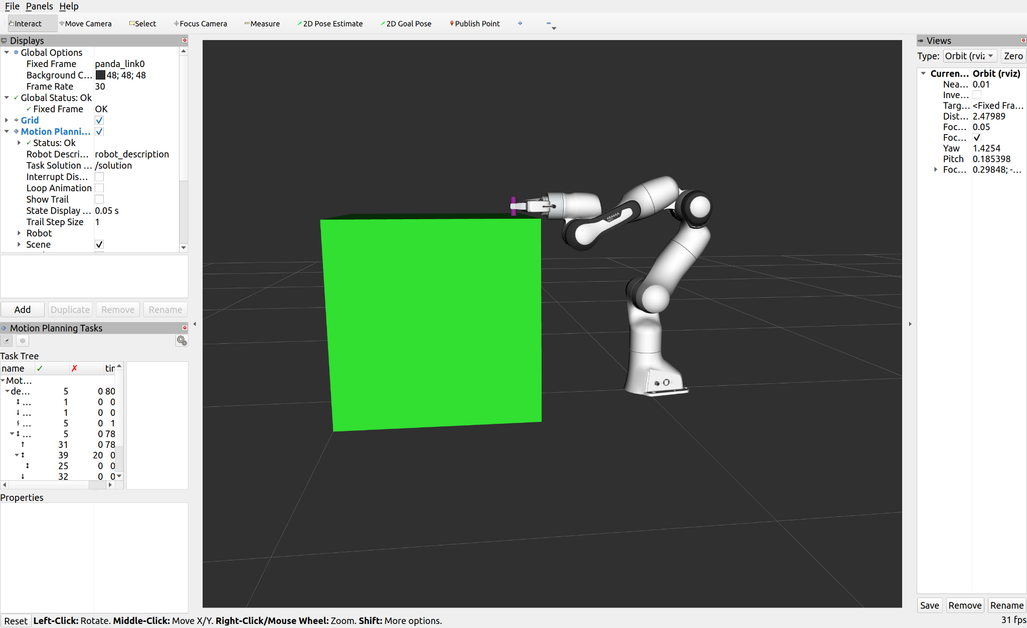
Task 2.1
Theresa Gräbner, Peishi Liu | Final Presentation | 20 August 2024
‹#›
Notes:
‹#›

Slide 13
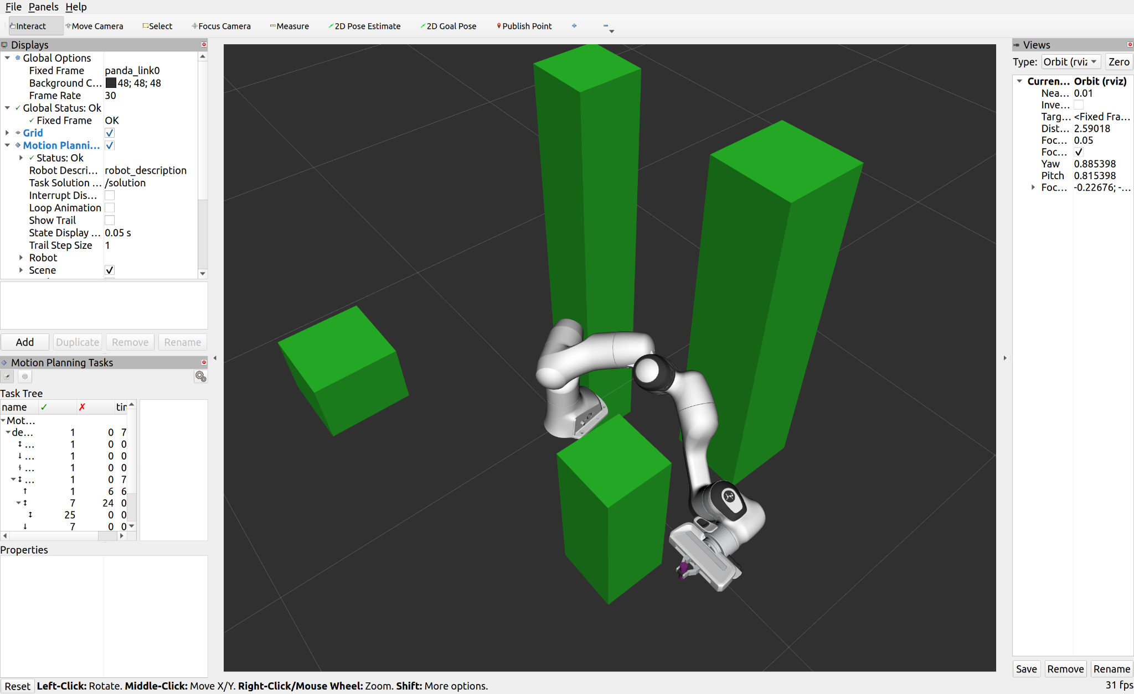
Task 2.1
Theresa Gräbner, Peishi Liu | Final Presentation | 20 August 2024
‹#›
Notes:
‹#›

Slide 14
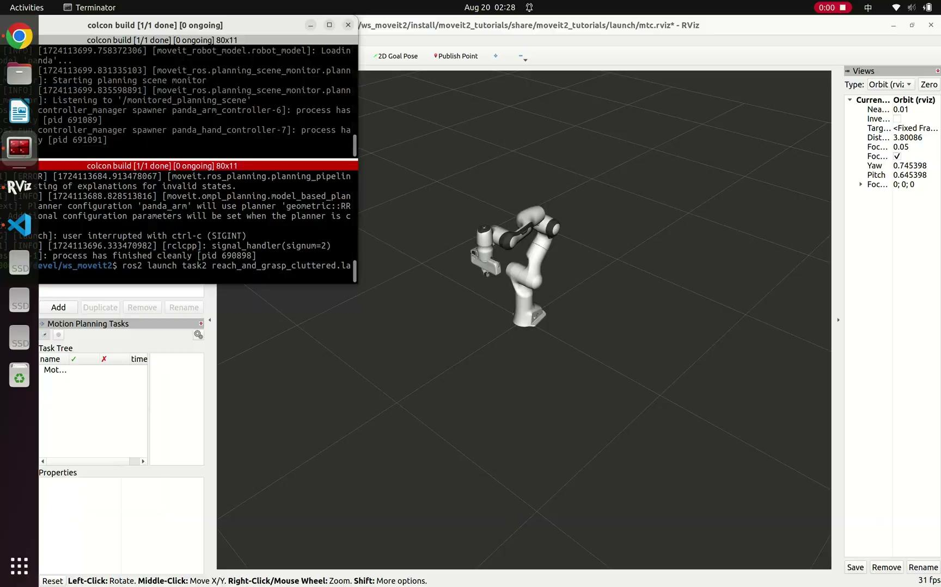
Task 2.1
Theresa Gräbner, Peishi Liu | Final Presentation | 20 August 2024
‹#›
Notes:
‹#›

Slide 15
Task 2.1
Create planning scene: add collision object
Create Task
Initialize current state
Stage: open_hand (interpolation_planner)
Connection: move_to_pick(ompl)
Container: pick_object
approach_object(Cartesian planner)
grasp_pose(interpolation_planner)
allow_collisiom
close_hand
attach_object
Return_to_initialize_position(ompl)
Theresa Gräbner, Peishi Liu | Final Presentation | 20 August 2024
‹#›
Notes:
‹#›

Slide 16
Task 2.1
Exacute_task: calculate the path and execute
Waiting for EE reaching the desired position
Shut down ROS node
Theresa Gräbner, Peishi Liu | Final Presentation | 20 August 2024
‹#›
Notes:
‹#›

Slide 17
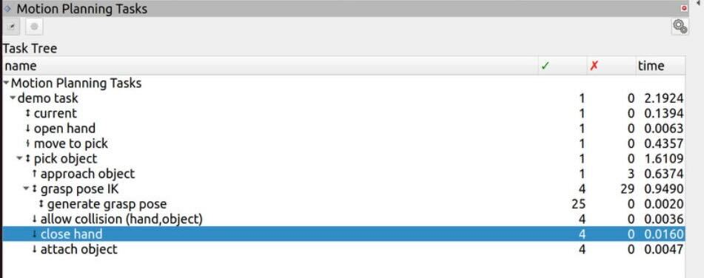
Task 2.1
Planning time
Theresa Gräbner, Peishi Liu | Final Presentation | 20 August 2024
‹#›
Notes:
‹#›

Slide 18
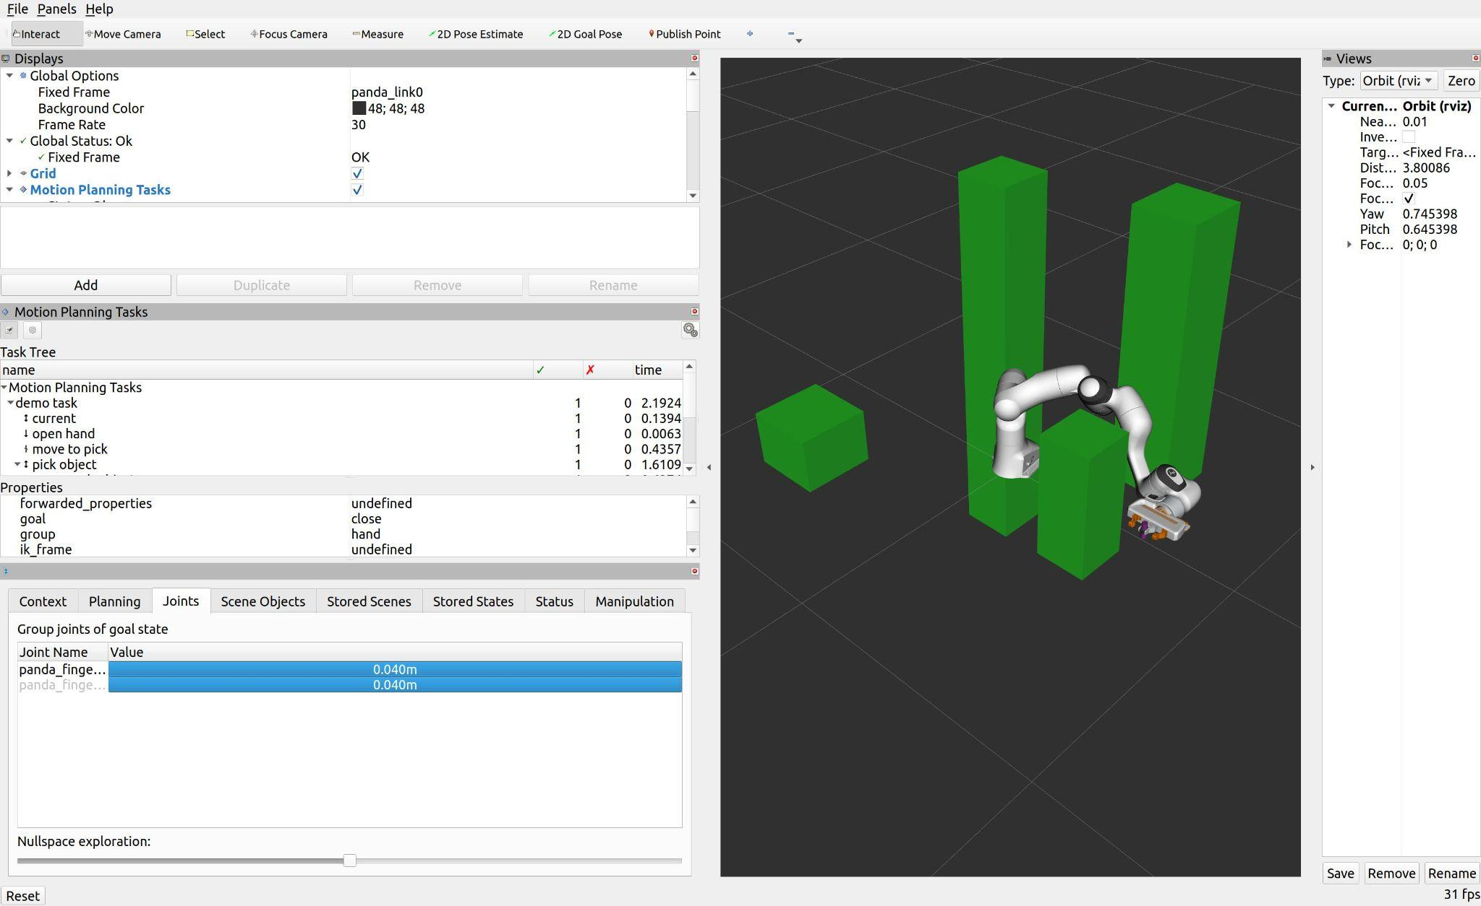
Task 2.2
Null Space:
As shown in the figure, the null space of the robot is limited to the movement of the finger, which ensures the static position of the end effector. Ideally, it should allow for greater internal freedom. However, due to time constraints, further investigation into additional factors is needed
Theresa Gräbner, Peishi Liu | Final Presentation | 20 August 2024
‹#›
Notes:
‹#›

Slide 19
Further Improvement
Divide the planning task into more detailed subtasks and create a Behavior Tree to activate different algorithms under different scenarios.
Adjust the boundary conditions and search steps, furthermore using weighted planning algorithms to speed up searching in relative empty space.
Theresa Gräbner, Peishi Liu | Final Presentation | 20 August 2024
‹#›
Notes:
‹#›

Slide 20
Task 3
Notes:
‹#›

Slide 21
Task 3.1
Goal: Pick up cuboid and hold it with both robots
Model: Pyrep’s Panda Robot
Libraries: PyRep
Implementation:
Move robots into starting position
Right Robot → 0.55 | 0 | 0.01
Left Robot → 0.7 | -0.1 | 0.3
Right Robot grasps cuboid + moves to [0.7, -0.01, 0.3]
Left Robot moves to [0.7, 0.01, 0.3] + grasps cuboid
Save times and paths
Turnover Time 1.60 s
Right grasps 1.59 s
Left grasps 3.19 s
Theresa Gräbner, Peishi Liu | Final Presentation | 20 August 2024
‹#›
Notes:
‹#›

Slide 22
Task 3.2
Goal: Pick up Cuboid and move it in dual-mode along a circular path
Model: Pyrep’s Panda Robot
Libraries: PyRep
Implementation: circular path in dual mode
Move robots to starting position
Calculate waypoints every 30 degree
For every waypoint:
Move robots to initialization configuration of waypoint
Calculatel 4 intermediate waypoints
Pyrep’s get_path_from_cartesian_path
Average time: 25.30 s
Measured without picking up cuboid
Theresa Gräbner, Peishi Liu | Final Presentation | 20 August 2024
‹#›
Notes:
‹#›

Slide 23
Task 3.2: Schema
[0.55 0 0.1]
Simulate pick-up of cuboid
[0.7 0 0.4]
Move robots to starting pose
No
Calculate Init-Configs
Use Init-Configs?
[0.55 0 0.02]
Right robot picks up Cuboid
[0.7 0 0.4]
Left robot grasps Cuboid
Move cuboid in dual-mode along circular path
Yes
Theresa Gräbner, Peishi Liu | Final Presentation | 20 August 2024
‹#›
Notes:
‹#›

Slide 24
Task 3.2: Initialization Configurations
Robot 1: Sample <= 10 valid joint configurations
Robot 1: changes configuration without moving end effector?
Robot 2: Sample <= 10 valid joint configurations
Robot 2: changes configuration without moving end effector?
Robot 1 + 2: PyRep finds path to next waypoint?
Save initialization configurations: {“Left:” [...], “Right”: [...]}
Theresa Gräbner, Peishi Liu | Final Presentation | 20 August 2024
‹#›
Notes:
‹#›

Slide 25
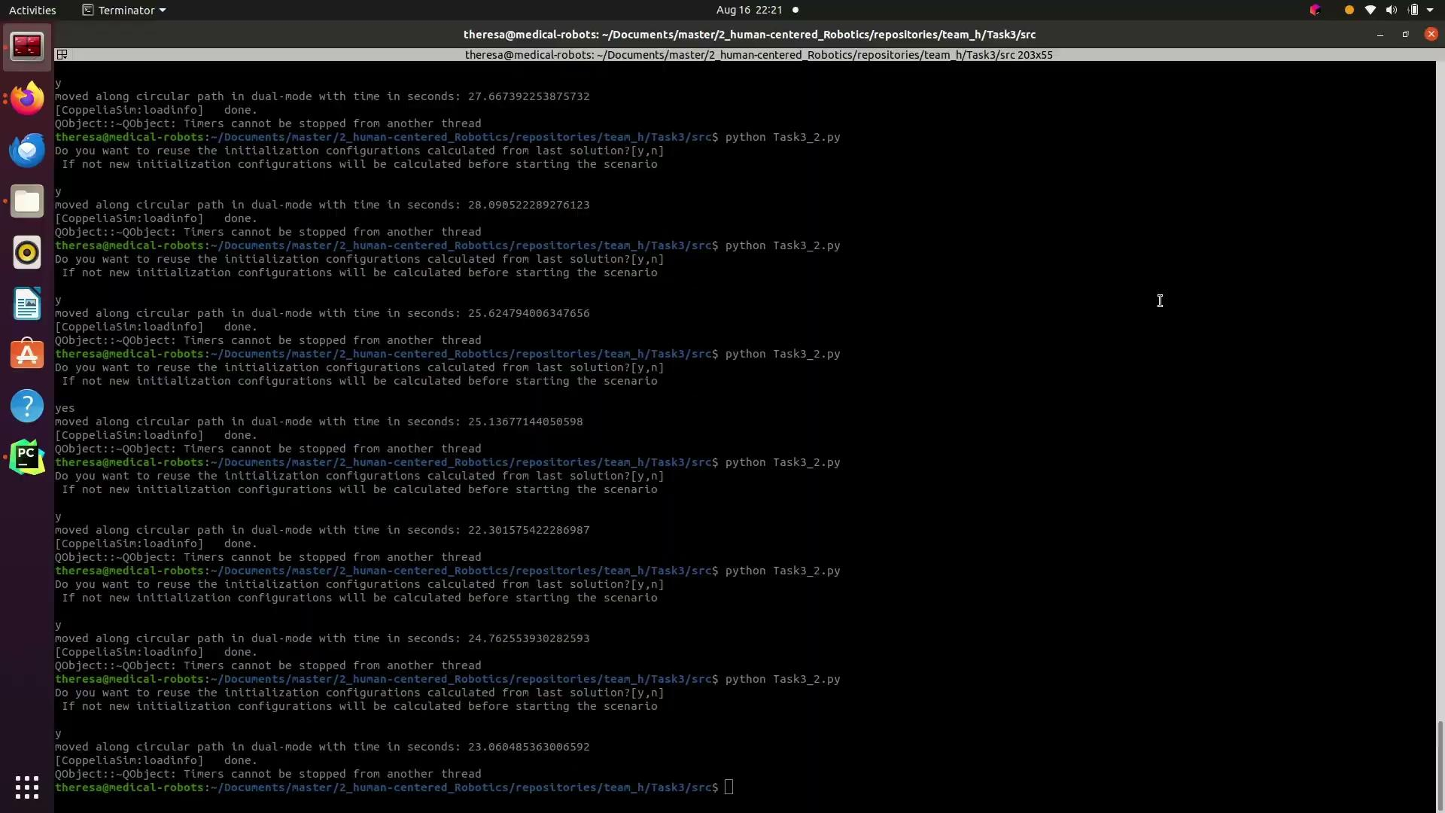
Result
Notes:
‹#›

Slide 26
Task 3.2: Limitations + Improvements
Discards configurations → initialization configurations takes longer to calculate
Needs to interrupt dual mode at 180 degrees
Improvement: Implement special control mechanism
Does not move end effector while moving to any new configuration leading to the new pose
No need to interrupt at 180 degrees
Theresa Gräbner, Peishi Liu | Final Presentation | 20 August 2024
‹#›
Notes:
‹#›

Slide 27
References
https://github.com/stepjam/PyRep
https://moveit.picknik.ai/humble/doc/tutorials/pick_and_place_with_moveit_task_constructor/pick_and_place_with_moveit_task_constructor.html
ARCL_23_24: team b
Theresa Gräbner, Peishi Liu | Final Presentation | 20 August 2024
‹#›
Notes:
‹#›

Slide 28
Questions?
Notes:
‹#›

